Slide 1
Blood Bank Management System
Analysis By Using MySQL

Slide 2
Introduction
Blood Bank Management System : is a database-driven application designed to manage and streamline the collection, storage, and distribution of blood and blood products. It ensures safe and efficient blood donation, tracking, and delivery to hospitals and clinics.
Key Features of the SQL-based System:
Centralized Database:
Stores donor information, blood inventory, and recipient details in a structured format.
Ensures data consistency, accuracy, and easy access.
Efficient Querying:
SQL queries enable real-time retrieval of data for tasks such as blood availability checks and processing donation records.
Data Relationships:
SQL facilitates the linking of related data (e.g., donors linked to their donation records and recipients linked to blood orders).

Slide 3

Database Design Overview
Donors: donor_id, name, contact_info, blood_type, donation_date, etc.
Blood Inventory : inventory_id, blood_type, quantity, storage_location, expiration_date, etc.
Recipients : recipient_id, name, contact_info, medical_condition, blood_type_needed, etc.
Blood Requests : request_id, recipient_id, blood_type_needed, quantity_requested, status, etc.
Donations : donation_id, donor_id, blood_type_donated, donation_date, volume, etc.
Payments : payment_id, recipient_id, amount, payment_date, payment_status, etc.

Slide 4
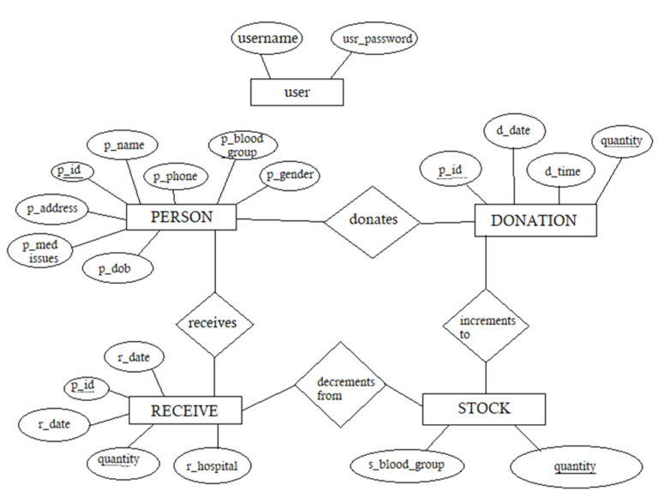
Relationships

Slide 5
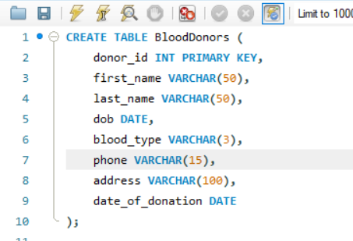
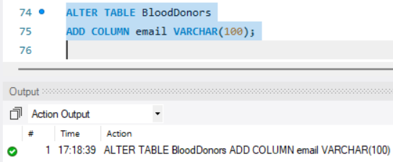
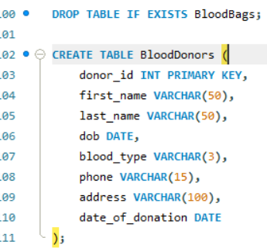
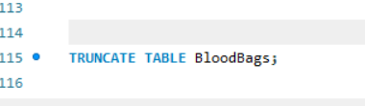
DDL– Data definition language
Create:
Alter:
Drop:
Truncate:

Slide 6
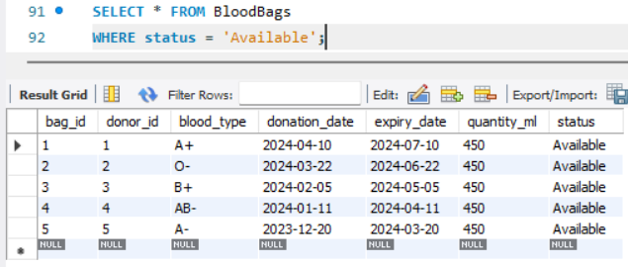
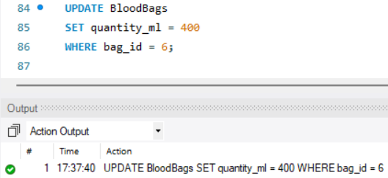
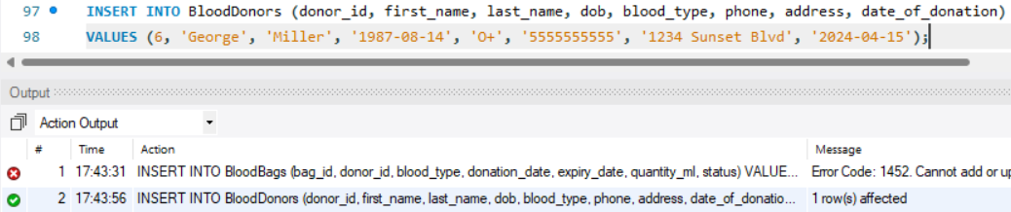
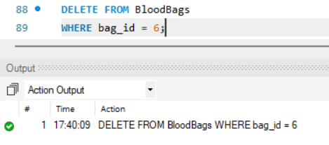
DML-Data Manipulation Language
Select:
Update:
Insert:
Delete:

Slide 7
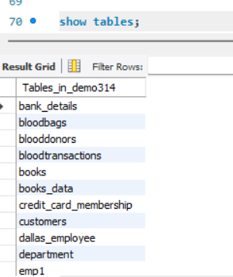
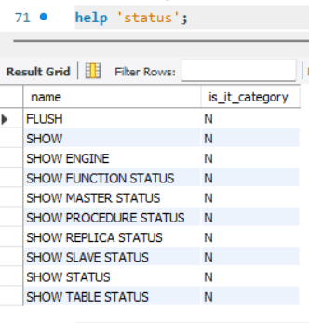
DQL-DATA QUERY LANGUAGE
Show:
Help:

Slide 8
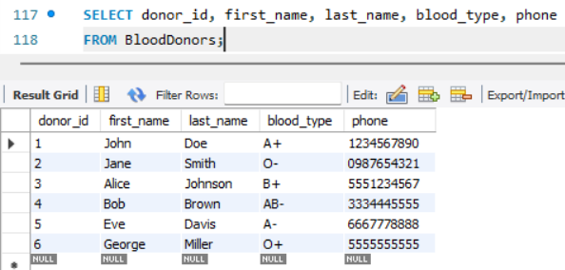
1.Retrieve a list of all the blood donors with their details such as first name, last name, blood type, and phone number ?
SELECT donor_id, first_name, last_name, blood_type, phoneFROM BloodDonors;

Slide 9

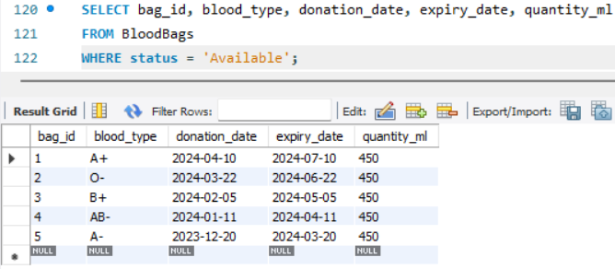
2.Find all the available blood bags in the blood bank and display their blood type, donation date, and expiry date2.
SELECT bag_id, blood_type, donation_date, expiry_date, quantity_mlFROM BloodBagsWHERE status = 'Available';

Slide 10
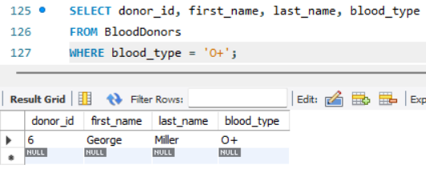
3.Retrieve a list of all donors who have donated blood of type 'O+'.
SELECT donor_id, first_name, last_name, blood_typeFROM BloodDonorsWHERE blood_type = 'O+';

Slide 11

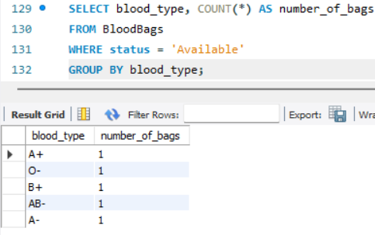
4.How many blood bags are available for each blood type?
SELECT blood_type, COUNT(*) AS number_of_bagsFROM BloodBagsWHERE status = 'Available'GROUP BY blood_type;

Slide 12
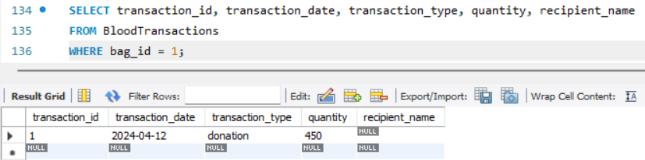
5.Retrieve the transaction history (donations/issued) for blood bag ID .
SELECT transaction_id, transaction_date, transaction_type, quantity, recipient_nameFROM BloodTransactionsWHERE bag_id = 1;

Slide 13

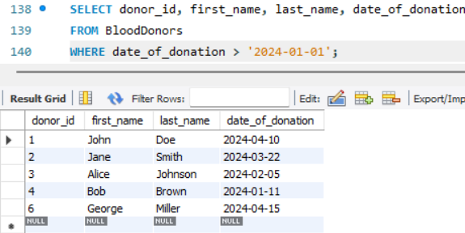
6.List all the donors who donated blood after '2024-01-01.
SELECT donor_id, first_name, last_name, date_of_donation
FROM BloodDonors
WHERE date_of_donation > '2024-01-01';

Slide 14

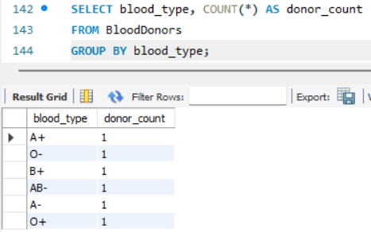
7.How many donors are there for each blood type?
SELECT blood_type, COUNT(*) AS donor_count
FROM BloodDonors
GROUP BY blood_type;

Slide 15
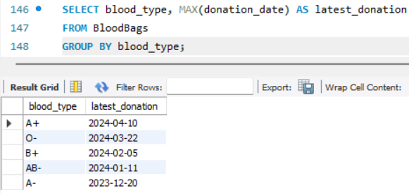
8.Retrieve the most recent donation for each blood type (i.e., the latest donation date).
SELECT blood_type, MAX(donation_date) AS latest_donation
FROM BloodBags
GROUP BY blood_type;

Slide 16
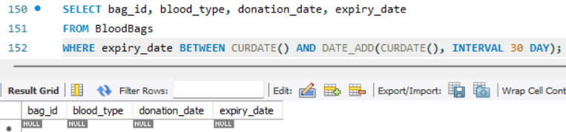
9.List all blood bags whose expiry date is within the next 30 days.
SELECT bag_id, blood_type, donation_date, expiry_date
FROM BloodBags
WHERE expiry_date BETWEEN CURDATE() AND DATE_ADD(CURDATE(), INTERVAL 30 DAY);

Slide 17
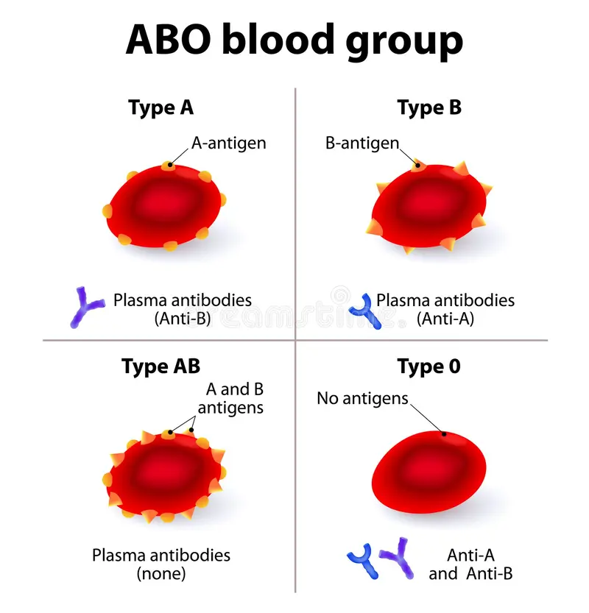
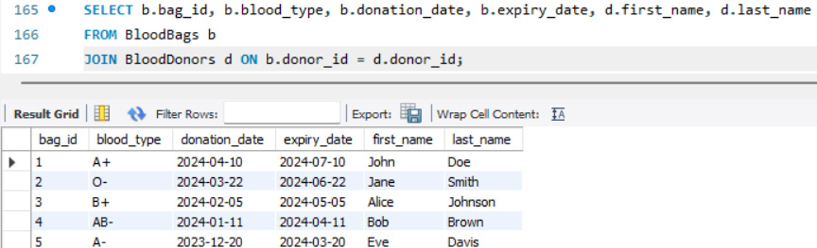
10.Retrieve a list of all blood bags along with donor information (first name, last name) for each blood bag.
SELECT b.bag_id, b.blood_type, b.donation_date, b.expiry_date, d.first_name, d.last_name
FROM BloodBags b
JOIN BloodDonors d ON b.donor_id = d.donor_id;

Slide 18
Future Enhancements
Challenges:
Challenges in matching rare blood types or finding universal donors.
Inefficient tracking of blood stock, leading to wastage or shortages.
Future Scope:
AI Integration Enhance donor-recipient matching and inventory predictions.
Real-time tracking of blood quality and storage conditions.

Slide 19
Conclusion
1. Ensures efficient and timely blood collection, storage, and distribution.
2. Enhances donor engagement and encourages regular donations.
3. Reduces wastage and improves inventory management.

Slide 20


